Slide 1
The Evolution of IT Service Management towards Cloud Service Management and Operations
Robert Barron
Snr. Solution Engineer
Cloud Adoption, Garage Method, and Solution Engineering IBM Cloud

Slide 2
The Evolving Application Landscape and the role of Service Management

Slide 3
What is Cloud Service Management & Operations
As defined in the IBM Architecture Center
https://www.ibm.com/devops/method/content/architecture/serviceManagementArchitecture
Cloud service management and operations refer to all the activities that an organization does to plan, design, deliver, operate, and control the IT and cloud services that it offers to customers.
Service management includes the operational aspects of your applications and services. After an application is pushed to production, it must be managed. Applications are monitored to ensure availability and performance according to service level agreements (SLAs) or service level objectives (SLOs).

Slide 4
Challenges with today’s IT landscapes –another reality!
… managing today’s applications is difficult because symptoms may not be visible
Mean Time to Repair for application-related problems is often 3-6 hours
Issues that go beyond Level 1 support often involve at least 3-4 people taking up an average of 5-7 total man hours
Increasingly complex hybrid cloud environments
User calls to applications support are the enterprise’s “heads up” for an application problem 35% of the time
58% of survey participants said their enterprise had between 6 and 40 different monitoring tools
Gartner – By 2018, 50% of the applications running in public cloud environments will be considered mission-critical by the organizations that use them.
IDC - By 2018, Over 60% of new apps will use cloud-enabled continuous delivery and cloud-native application architectures to enable faster innovation and business agility.
IDC FutureScape: Worldwide Cloud 2016 Predictions -Mastering the Raw Material of Digital Transformation, IDC, Nov. 3, 2015
Gartner Predicts 2016: Cloud Computing to Drive Digital Business 12/8/15 G00292047
3
Notes:
Challenges from the perspective of monitoring and managing rapidly expanding set of mission critical business apps while meeting growing demands for uptime and responsiveness
Detecting, diagnosing and resolving problems that occur in today’s applications are difficult because symptoms are hidden in a ‘big data’
Lack of end-to-end visibility on application performance impact to the business
When there is a problem, hard to diagnose across the entire application environment and resolve quickly
Costly and not effective at leveraging all IT operational data to find problems
Silo’s – Hard time switching across a bunch of tools slapped together

Slide 5
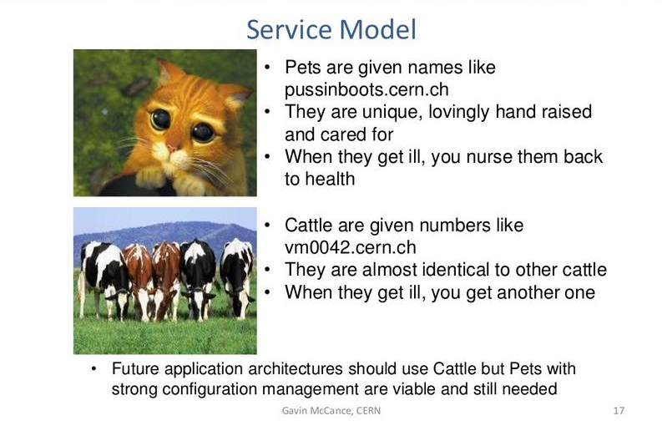
Cattle vs Pets

Slide 6
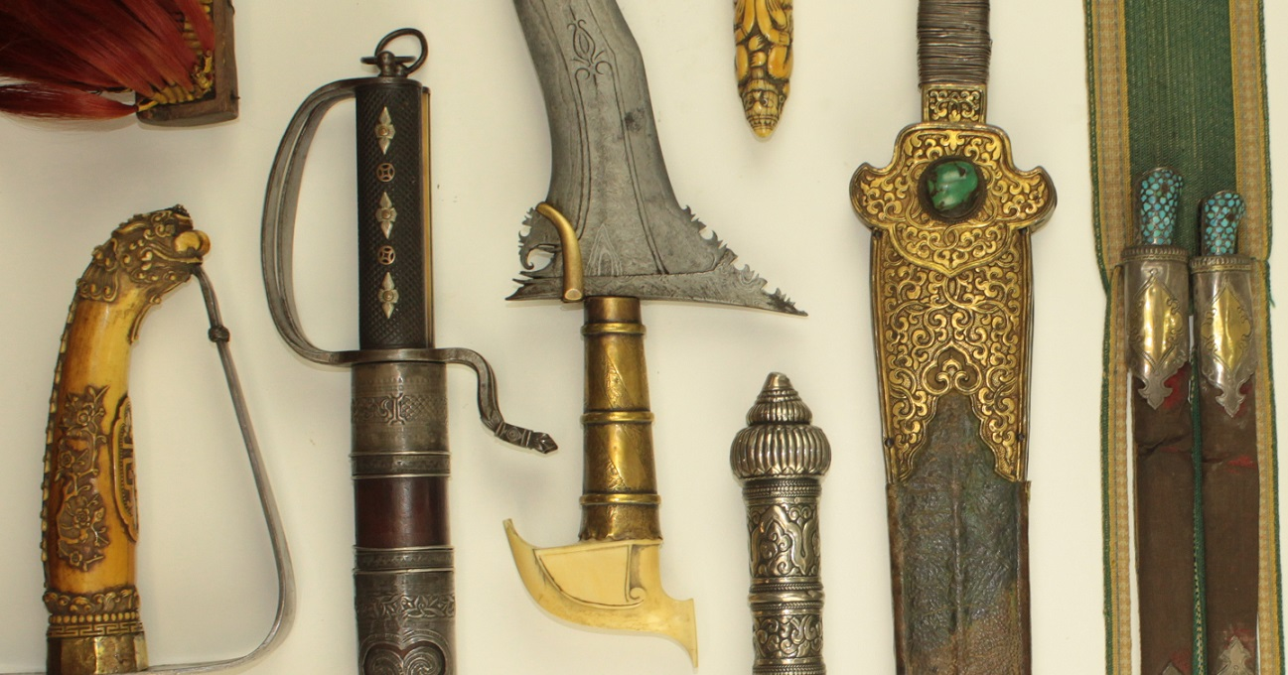

Changing Service Model
Heirlooms are given names. They are unique, hand crafted, well guarded and taken care of When they are damaged, they are repaired.
Plastic cutlery is disposable Plastic cutlery is mass-produced, using simple templates When damaged, is simply replaced from a pile

Slide 7

Operations Transformation – Organizational Change
Traditional
Enterprise IT
Co-exist
Large Enterprise
Moving to Cloud
Small
Startup
Enterprise DevOps teams – delivering Microservices as full-stack deployments. Design tor resiliency, testing, QA.
Full Stack DevOps Team
Dev – app development, deploy, test…(note: QA team omitted to keep simple)
join
Ops – Services & middleware:
request driven provisioning,
configuration, patch..
Site Reliability Engineers / Environment Ops - Centralized policy, governance, audit.
Ensure org compliance policy, interface with cloud provider, First Responders, define acceptance criteria for new Microservices, and automated tests, audits, triage.
split
Ops – infrastructure: Procurement, provisioning, OS patch, etc.
Third party cloud provider (ex: IBM)
Third party cloud provider (ex: IBM)
Application
Services / Middleware
DevOps personas need a view of their project
SRE / Environment Ops personas need a view across multiple DevOps teams
Traditional IT Ops needs view across both traditional and cloud environments
Infrastructure

Slide 8
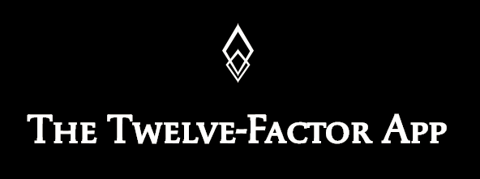
Logging in a Cloud-Native App
Logging
…
A twelve-factor app never concerns itself with routing or storage of its output stream. It should not attempt to write to or manage logfiles. Instead, each running process writes its event stream, unbuffered, to stdout. During local development, the developer will view this stream in the foreground of their terminal to observe the app’s behavior.
…
The event stream for an app can be routed to a file, or watched via realtime tail in a terminal. Most significantly, the stream can be sent to a log indexing and analysis system
…
https://12factor.net/logs
Logging Service

Slide 9
Bi-Modal IT Operations: A hybrid approach to operations
Slow, Traditional Mode
Fast, Agile Mode
Hybrid Ops
Agile Management
DevOps, Lean
Traditional Management
ITIL, CMMI
Some, big | Projects | Many, small
2-3 years | Time to go live | 2-3 months
Lower | Change rate | Higher
Centralized | Governance | Decentralized
Operational Excellence | Goals | Transformation & Differentiation
Democratized
Notes:
Source: The agile CIO: Mastering digital disruption. http://blog.kpmg.ch/the-agile-cio-mastering-digital-disruption/

Slide 10
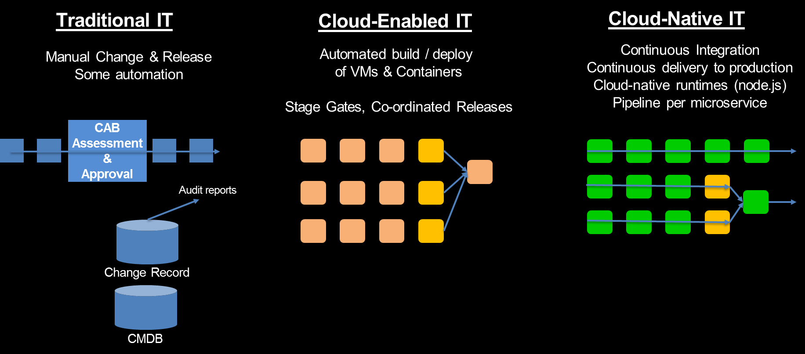

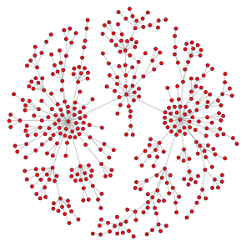
Change Management – Processes Change
Updates pushed automatically into the graph
Discovery,
„Scanners“
Cluster / Container-Manger push task info automatically into the graph
Topology / Relationship Graph to Identify the “blast radius” of a configuration change.
Notes:
Topology & Relationships to identify the blast radius of a configuration change.
Ein Standard-Change ist nach ITIL ein „vorab genehmigter Change, der von geringem Risiko ist, relativ häufig eingesetzt wird und einem bestimmten Verfahren oder einer Arbeitsanweisung folgt“.
Facilitate rapid response to fault & failures
Ease compliance auditing
Effective change management

Slide 11


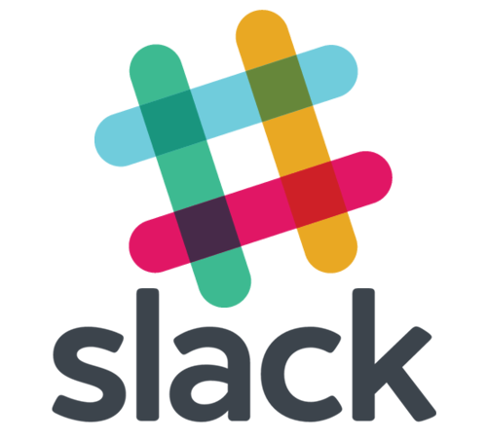

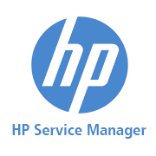




Technology Transformation – Tooling Changes
Traditional
Enterprise IT
Cloud-Native approach
Traditional Help Desk tools
Plus
Email
Phone
Bridge Calls
Instant Messaging (Skype, WhatsApp)
…
Modern
ChatOps
tools
L1
Instant Collaboration between SMEs …
Various Operations roles
Developers
Vendor / Provider
… and between Humans and Applications (ITSM, DevOps, etc.) through Bots
Persistent audit of communication
L2
L3, SMEs

Slide 12
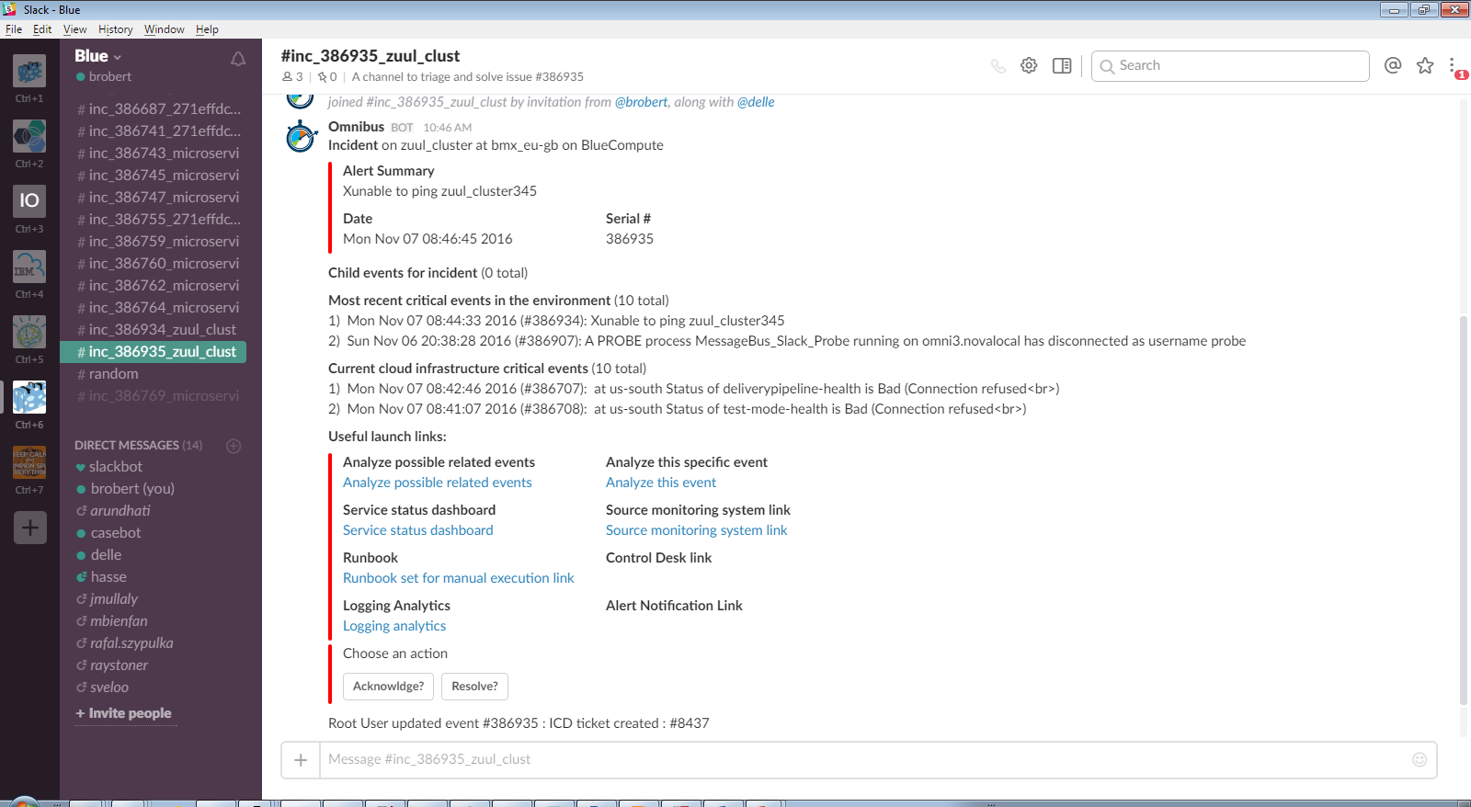
Incident Management ChatOps Rapid restoration of service through collaboration
Instant Collaboration between SMEs …
Various Operations roles
Developers
Vendor / Provider
… and between Humans and Applications through Bots
ITSM tools (i.e. escalation, related events)
DevOps tools (i.e. recent deployments, code author)
noi pull - retrieve the event from NOI noi ack - acknowledge the event noi deack – de-acknowledge the event noi ticket - open an ICD ticket for the event noi ans send - open an ANS alarm for the event noi journal - add a journal entry to the event noi resolve - resolve event (set severity to 0) noi critical - re-raise event (set severity to 5) noi sev # - set the severity of the event to # noi rba - retrieve the Runbook associated with the event noi list - show the latest events in the ObjectServer

Slide 13
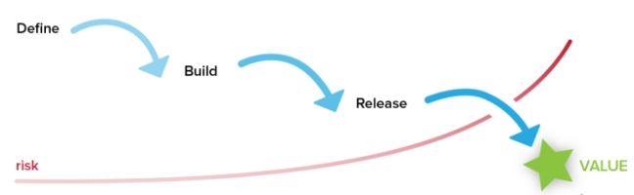
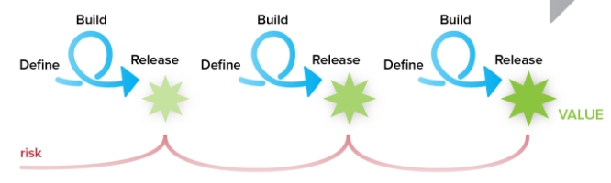
Cultural Changes
Traditional
Enterprise IT
Cloud-Native approach
Planned, process-oriented Goal to look good - „it‘s not me“ Saviour syndrom, „heros“ Goals per business unit Expertise Be protective of information Be comfortable in static environment Risk-averse Reaction to challenge : helplessness Default attitiude is „no“
Iterative, agile Goal to learn - blame-free, no finger-pointing Learning organization Common goals across all units Collaboration, Sharing Transparency Be comfortable with changes and dynamics Risk-receptive Reaction to challenge : resilience Default attitiude is „yes“

Slide 14
Operations Transformation – Relationship of CSMO and DevOps
ITIL
SRE
DevOps
Development
IT Operations
EnvOps
Cloud Service Management and Operations (CSMO)
DevOps
Environment Ops
Service Management,
ITIL, IT4IT, ZeroOutage
Site Reliability
Engineering
Notes:
Development and Operations come together in what is known as DevOps
Some Tasks are taken over by the Platform provider in an aaS consumption model
Environment Ops are the environmental tasks (power, AC, etc), but also the provisioning and Orchestration of environments (Test, QA, PreProd, integ, Support, Dev)
People ask if standard models like ITIL are still relevant in modern approaches like Agile, Cloud, DevOps
SRE is a new approoach to apply engineering concepts to operations: Automation, Improvements on the app and environment, Error-Budget
Some people think that Ops is not necessary at all, NoOps given practices like High-Availability, Auto-Scaling, Circuit-Breaker, Self-repair
All these aspects are coming together in IBMs Point of view on Cloud Service Management and operations, what we call CSMO.

Slide 15
Operations Transformation – Roles in Service Management
Incident Commander
First Responder
SME / Incident Specialist
Site Reliability Engineer (SRE)
Cloud Operator
Receives the incident information
Collaborates with SMEs to restore service
Updates key stakeholders with status and expected resolution times
Interfaces and works with vendors to isolate problems and drive resolution
Collaborates with 1st responder if more information is needed from customer
Brings the incident to closure
Opens Problem ticket for analysis and acceptance as a Problem
Receives the alerts via collaboration tooling
Research to determine if the problem real
Reviews known/existing issues to determine if outage is a known issue
Tries and resolves the issue via the prescribed runbooks
Gain concurrence from the customer it is resolved
If not solved, assignment to an incident owner occurs
Collaborates with Customer if more details are needed for problem resolution
Investigates the problem in Monitoring tools for more details.
Inspects logs
Tests and verifies issues
Recommends fixes if missing instruction for 1st Responder / Fixes the problem
Proposes changes if updates needed, Requests Change Management
Implements change
Provides data for SRE review
Ensuring a Durable Focus on Engineering
Full access to and authority to fix, extend, and scale the code to keep it working and harden it against threats.
Pursuing Maximum Change Velocity Without Violating a Service’s SLO
Focused on reliability, scalability and development of the Cloud infrastructure
Eliminate or reduce the losses through root cause analysis
Identifying Trends
Takes operational responsibility for the support of products & services running at global scale in a hybrid cloud environment where a highly automated service management approach is not yet possible
Will support the SRE function with identification and removal of “Toil” (repetitive manual labour which does not add real value)
Spend percentage of the working time in supporting engineering projects (Improvements)
First Responder are not the typical Level-1 support. Their responsibility and skill is rather a Level 2.5 support
Fundamentally, it’s what happens when you ask a software engineer to design an operations function.
Notes:
A site reliability engineer (SRE) will ideally spend up to 50% of their time doing "ops" related work such as issues, on-call, and manual intervention. Since the software system that an SRE oversees is expected to be highly automatic and self-healing, the SRE should spend the other 50% of their time on development tasks such as new features, scaling or automation. The ideal SRE candidate is a coder who also has operational and systems knowledge and likes to whittle down complex tasks.
Responsible for availability, latency, performance, efficiency, change management, monitoring, emergency response, and demand forecasting and capacity planning

Slide 16
Incident Management Tool Chain
IBM
3rd Party
Dashboards & Reporting
BMX OpsConsole
DASH
Grafana
Monitoring
Runbooks
Prometheus
RBA
Cloud Monitoring
BAM
Event
Management
Notification
Collaboration
APM
Slack
NOI
ANS
Logging
Ticketing & Trending
Elasticsearch
Log Analysis
ICD
Monitor
Analyze
Plan
Execute
15

Slide 17
How Many 9s Do You Need?
Uptime | Downtime per month | Downtime per year
99.999 % | .4 min | 5 min
99.99 % | 4 min | 52 min
99.9 % | 43 min | 8h 46m
99,5 % | 3h 36m | 1d 19h 48m
99 % | 7h 12m | 3d 15h 36m
Not every service needs a 5-9s availability target.
Risk vs. Reward
How much downtime can the business tolerate ?
Cattle Availability vs Pet Availability
X3 redundancy can be cheaper and easier than X2 redundancy
Well engineered business
Well engineered operations
Well engineered software
Cheap
Fast
Efficiency
Velocity
pick two
pick two
Good
Availability

Slide 18
Build To Manage – How to build manageable applications
As Development and Operations come closer together, new practices arise to better enable operations for cloud-based applications.
Shift Left: Build manageable applications / micro-services
Practices Include
HealthCheck API
Metrics
Deployment Correlation
Topology Information
Log Format and Catalog
Distributed Tracing
Event Format and Catalog
Monitoring Configuration
First Failure Data Capture
Test Cases and Scripts
Runbooks
Documentation
manageability
management
Health API
Runbook
Events
Logs
Application / Micro Service
(Managed entity)
Manageability defines how managed entities communicate with management functions
Management Tool
Management System
Application-specific Management Instrumentation
Component of the Management Stack

Slide 19
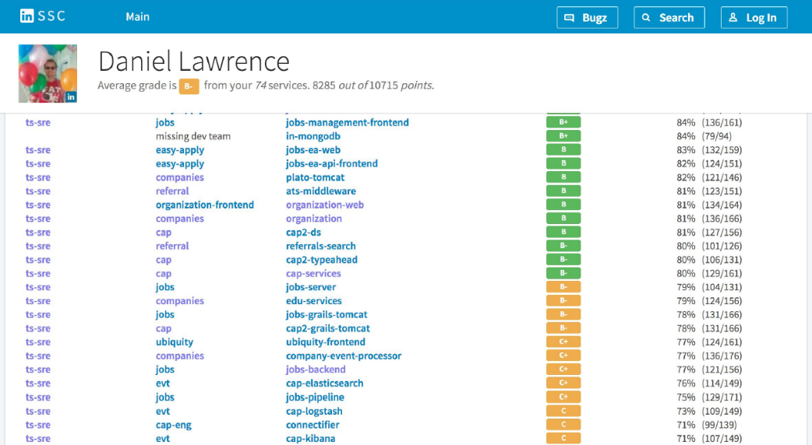
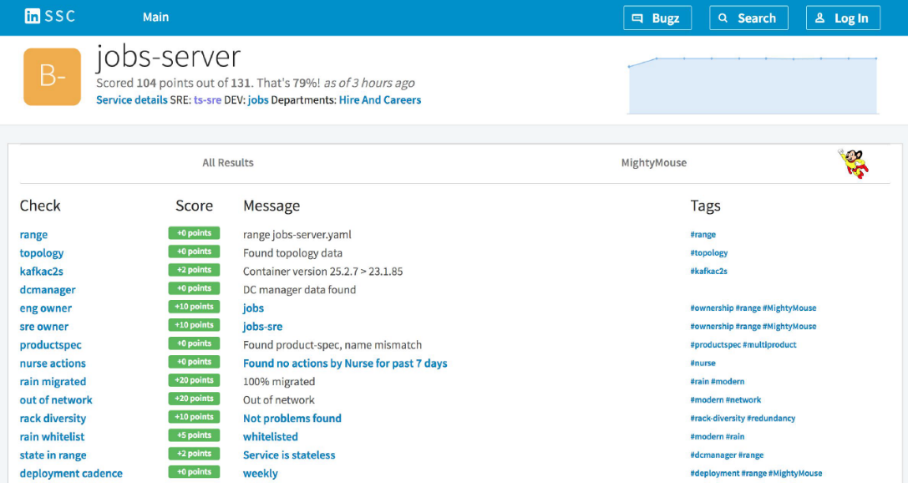
Build To Manage Scorecard
Scorecard, a way to measure how good / back
Weight behind each requirement
Script for each check
Automatically executed against each services
Tally up the results of the checks
“Highscore” scorecard, publish scores to the company
Scorecard provides clear guidance on how to get higher grades
Scores generating consequences (carrot & stick)
No support for F grade services
No deploy moratorium for A-grade service
A-grade services can deploy 24/7
Priority build for good services
Dispatch Tiger teams for F-grade services
Source: Daniel Lawrence, SREcon17 https://www.usenix.org/conference/srecon17americas/program/presentation/lawrence

